Slide 1
Geography & archaeological theories related to the Aztec, Maya & Inca

Slide 2
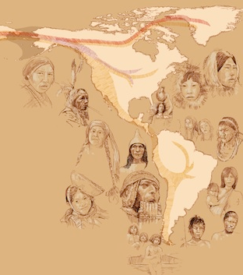
THEORY 1: Bering Strait Land Bridge
Humans migrated from Asia to the Americas via a land bridge between _________________ and Alaska
A 1600 km wide land bridge existed during the Pleistocene era when there were more _______________ than today and sea levels were about 60 metres lower
They were likely hunter-gatherers following herds of ______________
This theoretical migration probably took place around _____________ years ago

Slide 4
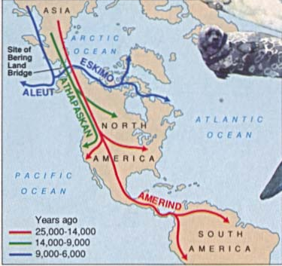
THEORY 1: Bering Strait Land Bridge
EVIDENCE:
Deep-sea core samples show that ________________ was present at this time
DNA & ____________________ evidence link peoples of the Americas to groups in Asia
PROBLEMS WITH THE THEORY:
Short _________________ to reach southern tip of South America after arrival
(Controversial) evidence of cultures in the Americas ___________ than the last glacial period
Notes:
Only a few thousand years between theorized crossing of land bridge an evidence of civilizations throughout the Americas, so could these migrants have populated two continents in that time?

Slide 5
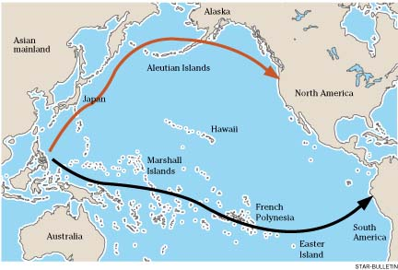
THEORY 2: Pacific Coast Migration
Humans reached the Americas by ____________ travel following the coastlines from northeast Asia to the Americas or by “island hopping” through the South Pacific
Helps explain how humans came to occupy so much territory in a _____________ of time
May have happened _________________ with land migrations
Notes:
Coastal areas would have also attracted inhabitants because of their rich food supply

Slide 6
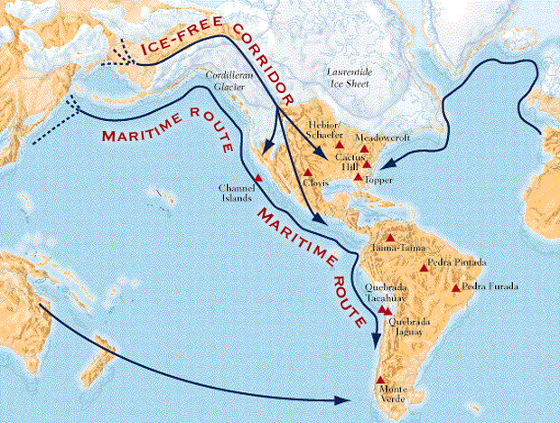

Slide 7
THEORY 2: Pacific Coast Migration
EVIDENCE:
_____________ & linguistic evidence link peoples of the Americas to groups in Asia
Boat building and __________________ occurred early enough in Asia for it to be possible
Evidence of settlements in _________________ areas
PROBLEMS WITH THE THEORY:
Sea levels have risen since last ice age, so possible evidence of coastal migrants is ____________________
Notes:
Some (controversial) evidence along the coast pre-dates archaeological evidence thought to prove the Beringia theory

Slide 8
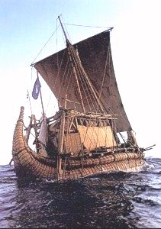
THEORY 3: Atlantic Coast Migration
Humans came to South America from _______________ via papyrus reed boats
May explain why there is little evidence of the great civilizations of Aztec, Maya and Inca developing ____________________________
May also explain why the Incas and Aztecs were not _______________ to encounter the Spanish
Notes:
Theory is that advanced cultures of the Maya, Inca and Aztec were imported in an already mature form
Both Aztec and Incan legends tell of white-skinned, bearded men that came from across the sea with the “secrets of civilization”

Slide 9
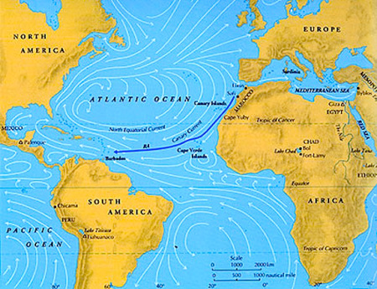

Slide 10
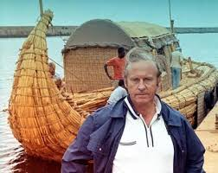
THEORY 3: Atlantic Coast Migration
EVIDENCE:
Art depicting _________________ in Peru, Egypt and Easter Island
Cultural similarities, including worship of a _____________ and bird-headed god, building of pyramids
Thor Heyerdahl proved such a voyage was ________________ by recreating it
PROBLEMS WITH THE THEORY:
Egyptian civilization _____________ about 2000 years before Aztecs, Maya and Inca emerged
Notes:
Could be that key aspects of Egyptian culture were transmitted to another Mediterranean culture, like the Phoenicians, and transported to Americas from there

